Slide 1
Business Continuity Planning
IS 380

Slide 2
What does a BCP do?
Provides detailed procedures to keep the business running and minimize loss of life and money
Identifies emergency response procedures
Identifies backup and post-disaster recovery procedures

Slide 3
Why have a BCP?
Reduce the risk of financial loss by improving the company’s ability to recover and restore operations.
Notes:
P782

Slide 4
BCP Steps
Project initiation
Conduct the business impact analysis (BIA)
Recovery strategies
Plan design and development
Implementation
Testing
Continual maintenance
Notes:
P780

Slide 5
Disaster recovery and security
Companies are more vulnerable to penetration immediately after a disaster.
Notes:
P778

Slide 6
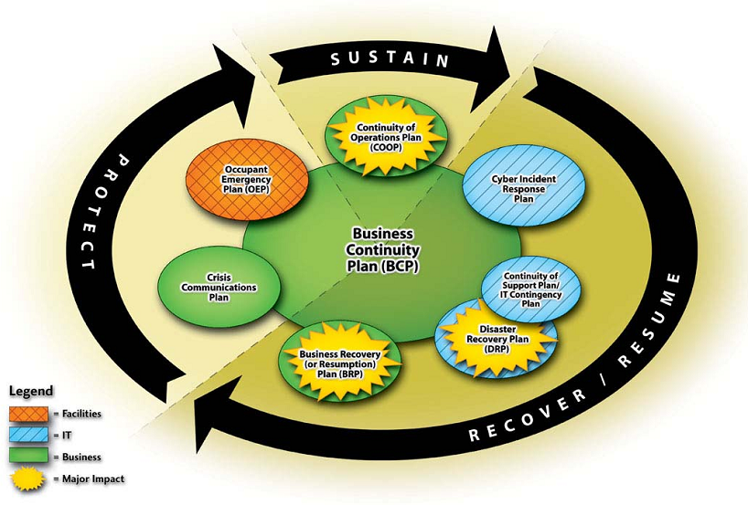
NIST 800-34
Notes:
http://csrc.nist.gov/publications/nistpubs/800-34/sp800-34.pdf

Slide 7
Continuity planning statement
A business continuity coordinator should be identified
Should have senior management approval
Every department should be involved
Should include a budget, milestones, deadlines, and identify tasks and success factors.
The people who develop the BCP should also be the ones who execute it.
Notes:
p783

Slide 8
Due Diligence
Sr. management may be legally required to have a BCP.
Maintain confidentiality of information
Maintain integrity of information, etc.
Notes:
p786

Slide 9
Business Impact Analysis
Interviews employees and partners
Documents business functions
Identifies criticality of each function
Identifies possible threats to the business

Slide 10
BIA (Continued)
For each threat, the BIA should identify:
Maximum tolerable downtime
Operational disruption
Financial considerations
Regulatory responsibilities (What is the law?)
Reputation and branding

Slide 11
BIA (Continued)
Threats can be manmade, natural, or technical
The BIA should consider:
Equipment malfunction
Unavailable utilities
Unavailable facility
Unavailable vendor/service provider
Software/data corruption or loss

Slide 12
Types of loss (not a complete list)
Reputation
Contract violation
Loss in revenue or productivity
Legal violations
Increase in operational expense

Slide 13
MTD – Maximum Tolerable Downtime
Nonessential
Normal
Important
Urgent
Critical

Slide 14
Preventative measures
Must be implemented to be effective
Must be cost effective
Should map to the threats and levels of criticality identified in the BIA
Notes:
p793

Slide 15
Preventative measures (cont)
Fortification of facility/site
Redundancy (servers, network)
Redundant vendor support
Insurance
Data backup
Fire detection/suppression
Spare equipment

Slide 16
Recovery
Hot site – Just add data
Warm site – Needs data and systems
Cold Site – You just get the building
Redundant site – A mirror site, fully owned
Consider costs, time to get operational
Must be tested
Tertiary Site – “backup to the backup”
Notes:
p798

Slide 17
Recovery (cont)
Tertiary Site – “backup to the backup”
Reciprocal agreement – two companies back each other up
Cheap but a lot of issues
Offsite location – the further the better.
Rolling hot site – do something with all those unused shipping containers.
Multiple processing centers – failover in seconds
Notes:
p798

Slide 18
Other recovery considerations
Human resources (AKA getting people to work)
Voice and data systems
Data backups
Supplies (Where are the paper clips and pens?)
Documentation
Notes:
p803

Slide 19
Facility Recovery
Nondisasters
Disasters
Catastrophe

Slide 20
Hardware recovery
MTBF – mean time between failures .
MTTR – mean time to recover
Notes:
p797

Slide 21
Backups
Hardware backups – restoring images?
COTS – commercial off the shelf
Software backups – store OS and software install media at both sites.
Keep data offsite too.
Software escrow – for one-off ‘custom’ software, a copy of source code is stored with a 3rd party.

Slide 22
Document
Procedures
Responsibilities
Roles and Tasks
Initiation, Activation, Recovery, Reconstruction, Appendix

Slide 23
Human Resources
Will people make it in ?
Executive succession planning
Two people can not be on the same bus at the same time.
Phone tree – where to report

Slide 24
Backups
The archive bit
Full backup – clears archive bit
Differential backup – everything since full – archive bit left alone
Incremental – everything since last incremental; reset archive bit
Store onsite and offsite

Slide 25
Backups
Image backup
Bare metal recovery (BMR)
Previous versions - Windows Vista/2008
Periodically test backups
Bad drive
Old tape
etc

Slide 26
Redundancy
Disk shadowing – RAID1
Disk duplexing – additional controller card.
Electronic vaulting – copies of files periodically transmitted offsite.
Remote Journaling – xmit delta, usually databases in real time. Can avoid corruption issues
Electronic tape vaulting – essentially backing up to a large remote tape library.

Slide 27
CDP
Continuous Data Protection
Point in time recovery - you can ‘go back in time’ to just before the problem.
Great for data corruption issues, delete or altered files.
Continuous VS near continuous.
A little like Apple’s ‘Time machine’, Windows ‘Previous versions’

Slide 28
Replication
Synchronous replication
Asynchronous replication
DFS replication (Windows 2008) and rsync (Unix)

Slide 29
cyberinsurance
Hacking, DOS, data theft, etc.

Slide 30
Testing
Checklist test (manager review)
Structured walk through
Simulation test
Parallel test
Full interruption test

Slide 31
Maintaining the plan
The BCP should be integrated with change management
Personnel changes need to be taken into account
Drills should be done regularly to identify where holes have developed
Identify people responsible for maintanence

Slide 32
In Class Lab
Group | Type | Threats | Preventative measures | Recovery strategies
A | Educational
B | Financial
C | Military
D | Hospitality

